Slide 1
PROCESS DESIGN
by
Mustafa Shiraz Ahmed

Slide 2
The Challenge of
Process Design
Creativity is key
  the Rule of Whacko: cultivation of the absurd
The intimidation of the blank sheet of paper
  if we don' t automate or tinker, what are we going to do?
  where do we start? and how?
The bad news about design
  it' s not algorithmic

Slide 3
The Challenge of
Process Design
The good news about design
  it' s not magic and it need not be haphazard
  there are recurring patterns
Our approach: jump- start the creative process
  models and templates to stimulate possibilities
  a catalog of patterns

Slide 4
Patterns for High Performance Process Design
Relocate work to customers: from performer to enabler ( redefine value- added from result to capability)
  electronics: equipment maintenance
  manufacturing: small- scale purchasing

Slide 5
Patterns for High Performance Process Design
Relocate work from customers: add more value ( optimize total process performance)
  automotive: inventory management
  insurance: equipment maintenance
  chemicals: quality inspection
  aircraft engines: spare parts and maintenance
  insurance: quoting
  mortgage insurance: underwriting

Slide 6
Patterns for High Performance Process Design
Simplify: minimize number of interconnections and dependencies by integrating transactions and reallocating activity ( reduce complexity and reconciliation)
  consumer durables: warranty claims, accounts payable
  retailing: merchandise planning
  insurance: claims payment
  insurance: policy replacement

Slide 7
Patterns for High Performance Process Design
Eliminate non- value- adding intermediaries
  insurance: claims processing
  farm products: distribution
  home building: contract approvals

Slide 8
Patterns for High Performance Process Design
Reconfigure and reorder steps to reflect potential parallelism and required precedence ( avoid letting linearity degenerate into iteration)
  high technology: product development
  electronics: order fulfillment
  health care: referral and admitting, pre- operative care

Slide 9
Patterns for High Performance Process Design
Make decisions early for efficiency ( of labor and capital) : predict, don ’t react
  consumer goods: route sales management
  electronics, financial services: customer service
  communications systems: manufacturing and sales
  entertainment: billing and auditing
  auto parts: product design
  fast food: order fulfillment

Slide 10
Patterns for High Performance Process Design
Make decisions late for flexibility: avoid premature choices
  apparel: semi- finished goods
  consumer goods: delivery routing
  personal computers: components procurement

Slide 11
Patterns for High Performance Process Design
Create hybrid centralized and decentralized structures ( virtual centralization, coordinated decentralization, standardization vs. diversity)
  electronics: purchasing
  banking: multi- divisional sales
  auto parts: tooling

Slide 12
Patterns for High Performance Process Design
Move work to the best location for it to be performed
  automotive: master parts picking
  fast food: kitchen operations
  chemicals: manufacturing

Slide 13
Patterns for High Performance Process Design
Integrate and compress tasks ( case workers and case teams) to eliminate handoffs and avoid iteration
  insurance: new business
  communications: maintenance and repair

Slide 14
Patterns for High Performance Process Design
Introduce an integrator to coordinate a diverse set of experts performing very complex tasks ( case manager and project management)
  property/ casualty insurance: complex claims management
  electric utility: customer service
  health insurance: disability rehabilitation
  communications systems: system delivery
  health care: treatment management

Slide 15
Patterns for High Performance Process Design
Perform the right amount of work for the situation ( avoid excessive standardization)
  computer services: accounts receivable, accounts payable
  auto insurance: policy issuance, claims
  universities: cross- charging

Slide 16
Patterns for High Performance Process Design
Decrease the range of alternatives: sacrifice precision for simplicity and convenience
  insurance: underwriting
  health care: materials billing
  mortgage insurance: claims

Slide 17
Patterns for High Performance Process Design
Increase the range of alternatives: pay for precision
  insurance: underwriting
  banking: pricing
  consumer goods: customer segmentation

Slide 18
Patterns for High Performance Process Design
Employ better information ( more current, more relevant)
  auto insurance: underwriting ( redux)
  consumer goods: product deployment

Slide 19
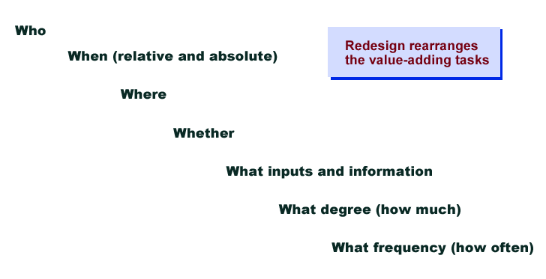
The Key
Dimensions of
Process Design

Slide 20
Principles of High
Performance Process Design
Work should be done by whoever is in the best position to do it
  irrespective of history or organizational boundaries
A process should be performed by as few people as possible
  to minimize handoffs
Do work at the best time for it to be done
  avoiding artificial linearity or generic rules

Slide 21
Principles of High
Performance Process Design
Location is a variable, not a given
  to be explicitly factored in
Strive for simplicity
  non- value- adding work breeds complexity
Structure in terms of alternatives rather than exceptions
  this keeps the basic flows clean

Slide 22
Principles of High
Performance Process Design
Consider the context when performing work
  the virtues of uniformity have been greatly oversold
Control must be subjected to cost- benefit analysis, just like everything else
  neither perfect nor free

Slide 23
Simplification and Rationalization
A useful adjunct to redesign
  not strictly holistic reorganization of process, but a source of improvement nonetheless
  redesign provides the context for surfacing and addressing a host of irrational aspects of operations
  often a useful basis for initial implementation

Slide 24
Simplification and Rationalization
Illustrations
  consumer goods: customer rationalization
  electronics: parts elimination
  distribution: warehouse consolidation
  electronics: channel simplification, package redesign, parts
  standardization
  consumer goods: truck fleet optimization, systems
  standardization, vendor consolidation

Slide 25
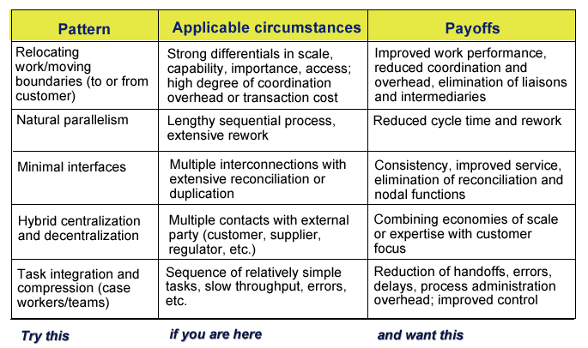
Guidelines for
Applying the Patterns

Slide 26
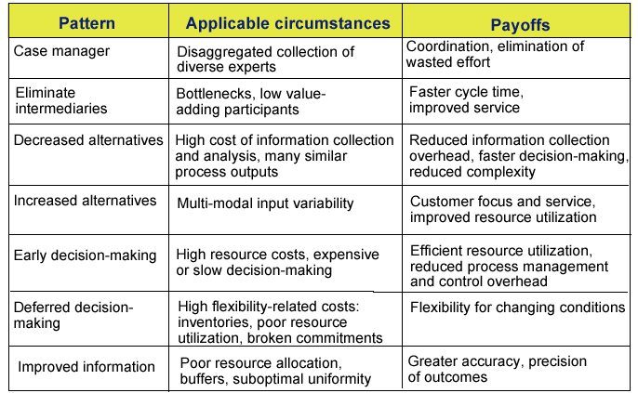
Guidelines for
Applying the Patterns

